Slide 1






The impact of Virginia public policy on Weekly cases, hospitalizations and deaths
CIC Working Group
Roland DePratti
Central CT State Unversity
4/03/2024

Slide 2

Data of Interest
Preprocessing
Time Series Analysis with SARIMAX
Time Series Analysis with ElasticNet
Final Conclusions

Slide 3
Data of Interest
State: RegionName/State (1,2)
Date: Date (1,2)
Predictors:
School Policy : C1M_School.closing (1) Mask Policy : H6M_Facial.Coverings (1)
Vaccine Policy : H7_Vaccination.policy (1)
Response Measures
New Cases: ConfirmedCases (1)
New Hospitaliztions: Hospitalizations (2)
New Deaths: ConfirmedDeaths (1)
1. Oxford Covid US Regional Data
OxCGRT_compact_subnational_v1.csv
2. CDC Weekly Hospitalization State Data
Virginia-Weekly-Hospitalizations.csv

Slide 4

Preprocessing
Generate New Cases and New Deaths
Subtract total cases and deaths from successive da
Examine Correlation Across Predictors and Responses
Replace Daily Negative Differences with Zero
Assumption corrections applied randomly to prior days
Generate Weekly Summaries
Sum Response Counts, Use Max Policy Indicators
Join Oxford and Hospitalization Data

Slide 5
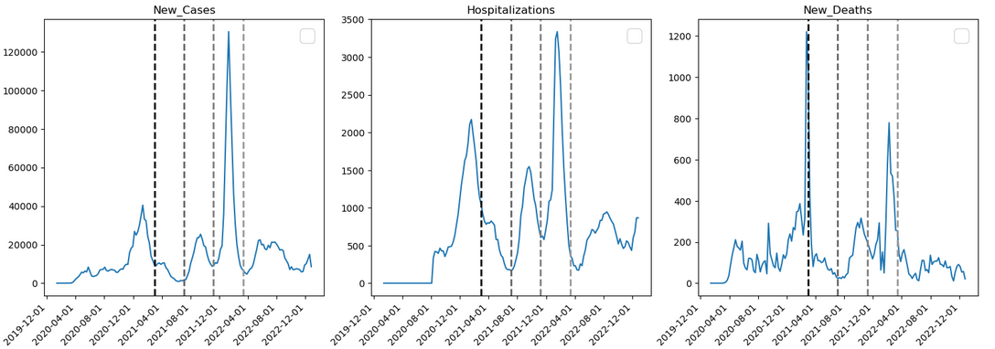
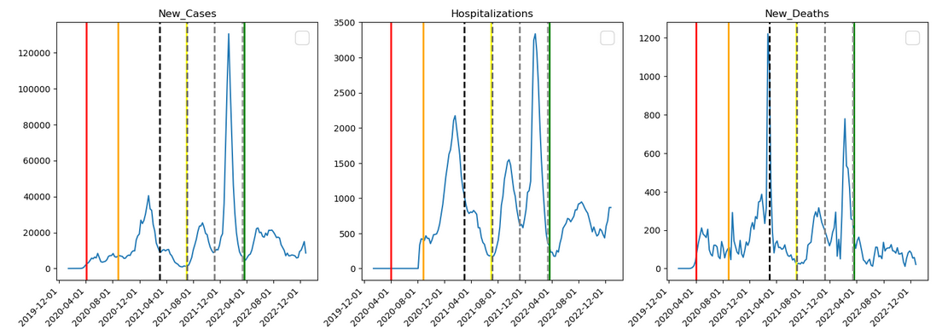
COVID-19 Strains, School Closings, and Outcomes

Slide 6
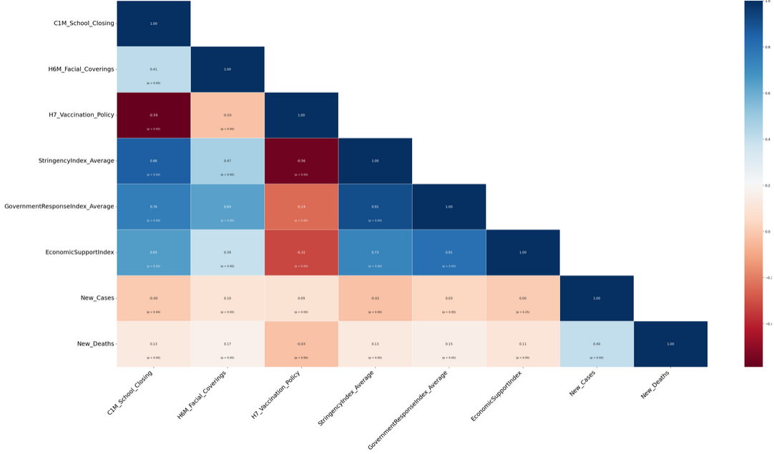
Correlation Across Predictors and Responses

Slide 7

SARIMAX Time Series Analysis
SARIMAX accounts for seasonality in Time Series Analysis
It also allows the user to submit additional predictors besides time.
Statistical analysis shows that all response variables exhibited stationality:
Test | New Cases | New Deaths | Hospitalizations
ACF | Stat: -4.0477, p-value: 0.0011 | Stat: -4.1561 p-value: 0.0007 | Stat: -3.7402 p-value: 0.0035
KPSS | Stat: 0.2979, p-value: 0.1 | Stat: .14309 p-value: 0.1 | Statistic: 0.362 p-value: 0.0931

Slide 8
Adjusting Predictors For Time Series Analysis
Examples:
Prior Predictors
P1W_C1M
P2W_C1M
P3W_C1M
A) Policy changes take a while to impact response.
- Add 1, 2, and 3-week Prior Predictors each week
B) The COVID policy predictors are on an ordinal scale.

Slide 9
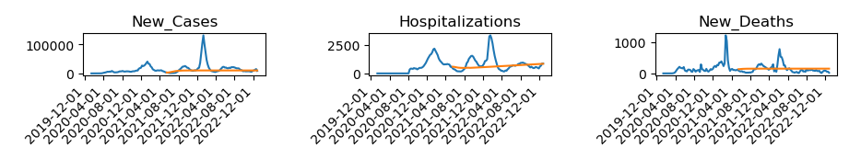
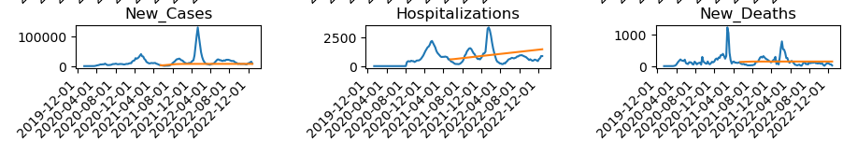
SARIMAX Time Series Actual vs Predicted Results
Time Series Model without Additional Predictors
Blue line is the actual,
orange line is predicted.
Predictions not very accurate.
Shikhar recommended a different library that I am following up on.
Time Series Model with Additional Predictors

Slide 10
Apply Elasticnet Algorithm
ElasticNet is a linear regression algorithm
It filters out the correlation between predictors (high coefficients)
It can eliminate predictors that are already represented in other predictors
(feature selection)
I supplied the algorithm with all the predictors and let it select the important ones
I then asked it to weigh predictors on importance (Very Important Features)

Slide 11
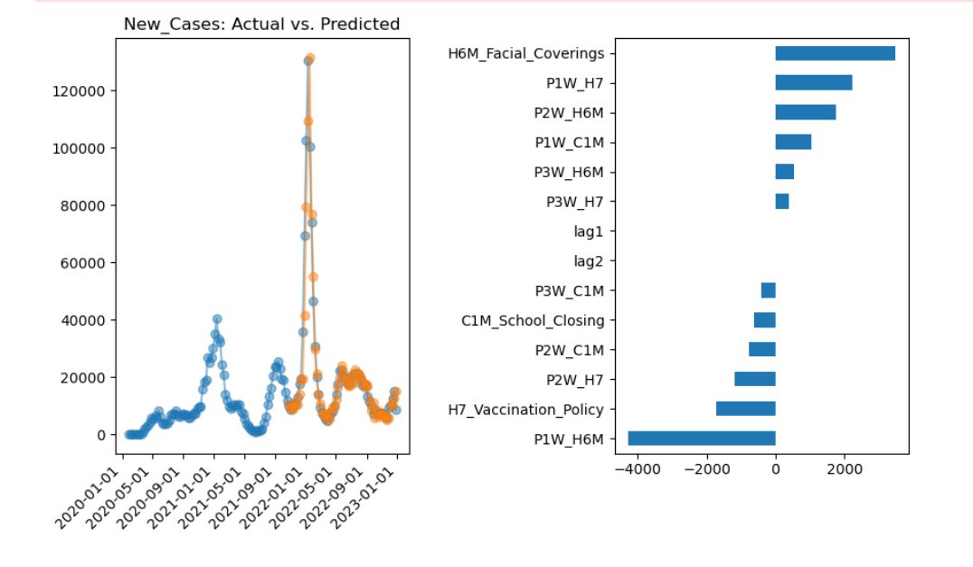
ElasticNet Weekly New Cases Model
Decreased Cases/Best Policy Indicators
Mask Policy
- 1 week prior
Vaccination Policy
- current
- 2 weeks prior
School Closing
- current
- 2,3 week prior
ElasticNet model is much more predictive than Sarimax (RMSE 7,721 vs 22,865)

Slide 12
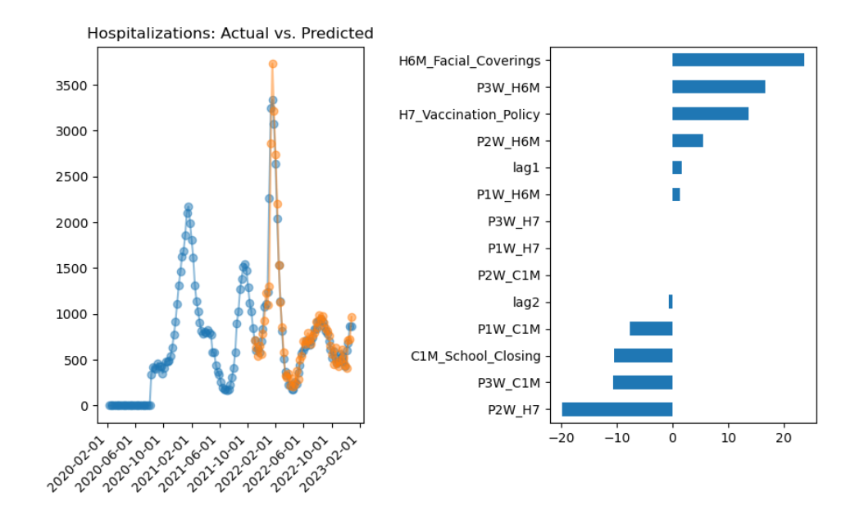
ElasticNet Weekly New Hospitalizations Model
Decreased Hosp/Best Policy Indicators
Vaccination Policy
- 2 weeks prior
School Closing
- current
- 1,3 week prior
Increase Hosp
Mask Policy
Current Vaccination Policy
ElasticNet model is much more predictive than Sarimax (RMSE 164 vs 684)

Slide 13
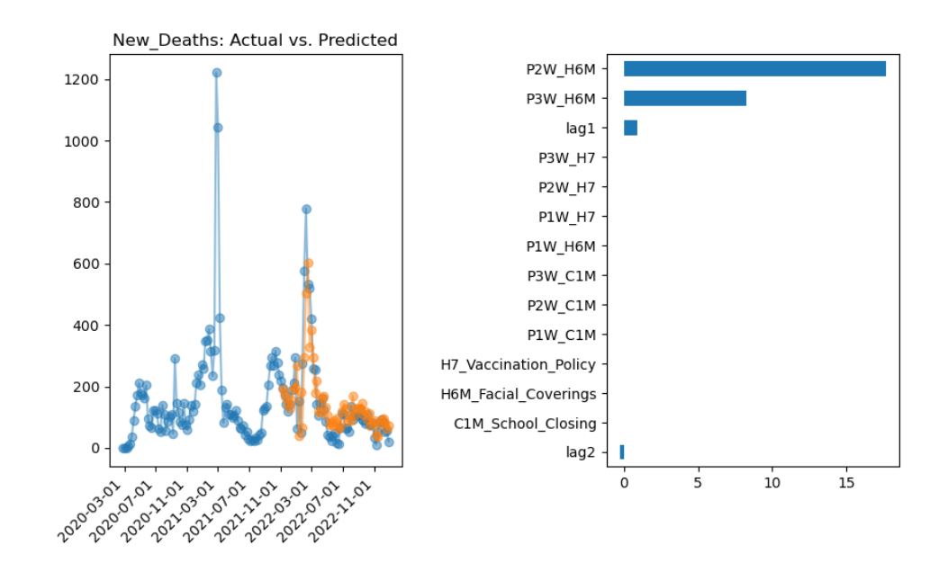
Elasticnet Weekly Deaths Model
Decreased Hosp/Best Policy Indicators
Deaths 2 weeks ago (lag2)
Increase Hosp
Mask Policy
- 2, 3 weeks prior
Deaths
- 1 week prior (lag1)
Elasticnet model is much more predictive than Sarimax (RMSE 82 vs 132)

Slide 14

Conclusions
ElasticNet models did a much better job predicting new cases, hospitalizations, and deaths than the SAMIRAX models
Mask, vaccination, and school closing policies had a high association with decreased new cases.
Prior weeks’ vaccination and school closing policies had a high association with decreased hospitalizations, but current mask and vaccination policy had a high association with increased hospitalizations
Prior 2 and 3-week mask policy was associated with increased deaths.

Slide 15
References
My GitHub Site
https://github.com/rdpratti/Analyzing-Pandemic-Response
Oxford Data
https://github.com/OxCGRT/covid-policy-dataset
CDC Hospitalization Data
https://data.cdc.gov/Public-Health-Surveillance/Weekly-United-
States-COVID-19-Hospitalization- Metr/akn2-qxic/about_data
SARIMAX Time Series Modeling
https://www.statsmodels.org/stable/examples/notebooks/generated/statespace_sarimax_stata.html
ElasticNet
https://machinelearningmastery.com/elastic-net-regression-in-python/

Slide 16

THANK YOU
Thank You
Roland DePratti
860-578-7315
roland.depratti@my.ccsu.edu
GitHub:

